Slide 1


Distributed Databases
Asif Sohail
University of the Punjab
Punjab University College of Information Technology (PUCIT)

Slide 2
Introduction
A Distributed Database is a single logical database that is spread across computers in multiple locations that are connected by a data communication network.
A distributed database management system (DDBMS) governs the storage and processing of logically related data over interconnected computer systems in which both data and processing are distributed among several sites.
It is extension to Decentralized Database, in which computers are not interconnected by a network.
In a distributed database system, a database is composed of several parts known as database fragments.
The database fragments are located at different sites and can be replicated among various sites. Each database fragment is, in turn, managed by its local database process.
The data processor (DP) is the software component residing on each computer or device that stores and retrieves data located at the site.
The transaction processor (TP) is the software component found in each computer or device that requests data.

Slide 3
Introduction
Different locations – Database --- Fragments --- Multiple sites
D = {F1, F2, …, Fn} => {S1,S2, …,Sm} 1:1, 1:M, M:N
D => {S1,S2, …,Sm} Full Replication
F1 at all the sites, F1 is frequently required at all sites, read only
As per need, Put the fragment where required mostly.
Replications F1 => S1, S2 (Reliability+, Availability+
S1 => F1, F2 …… Query from F3? Yes
Local Transaction F1,F2 100%
Global Transaction F3
Look n feel of a single system
S1,S2,…,Sm ➔D

Slide 4
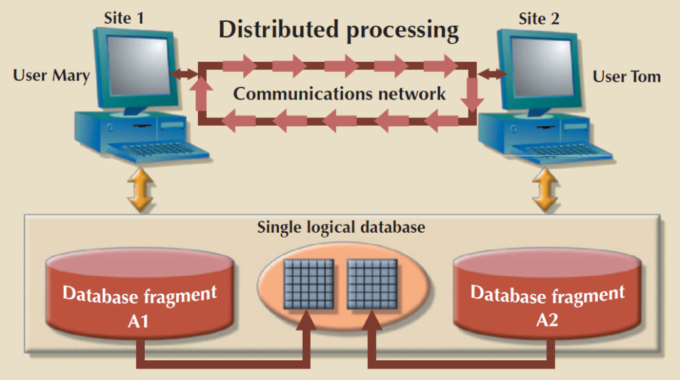
Introduction
All the “see” only one logical database. In fact, the end users do not even need to know that the database is divided into fragments, nor do they need to know where the fragments are located.

Slide 5
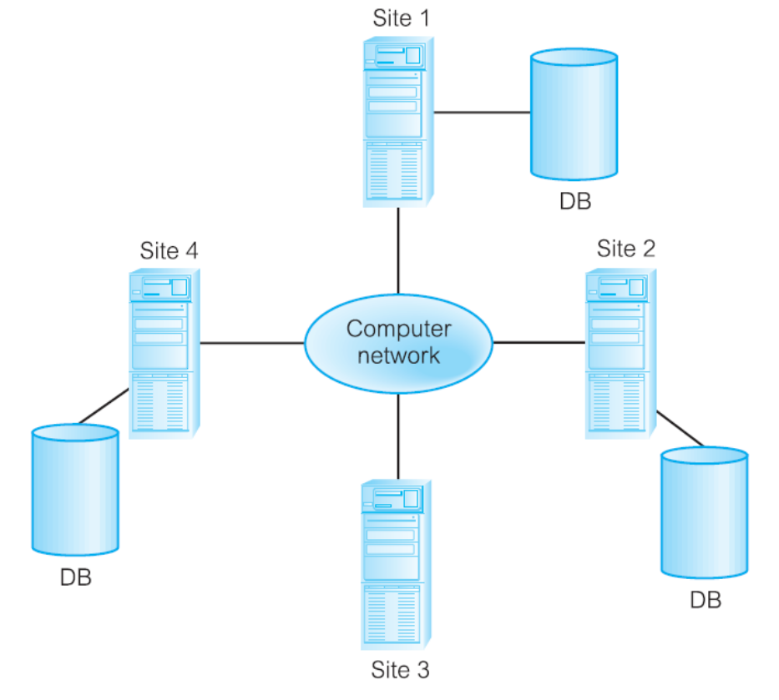
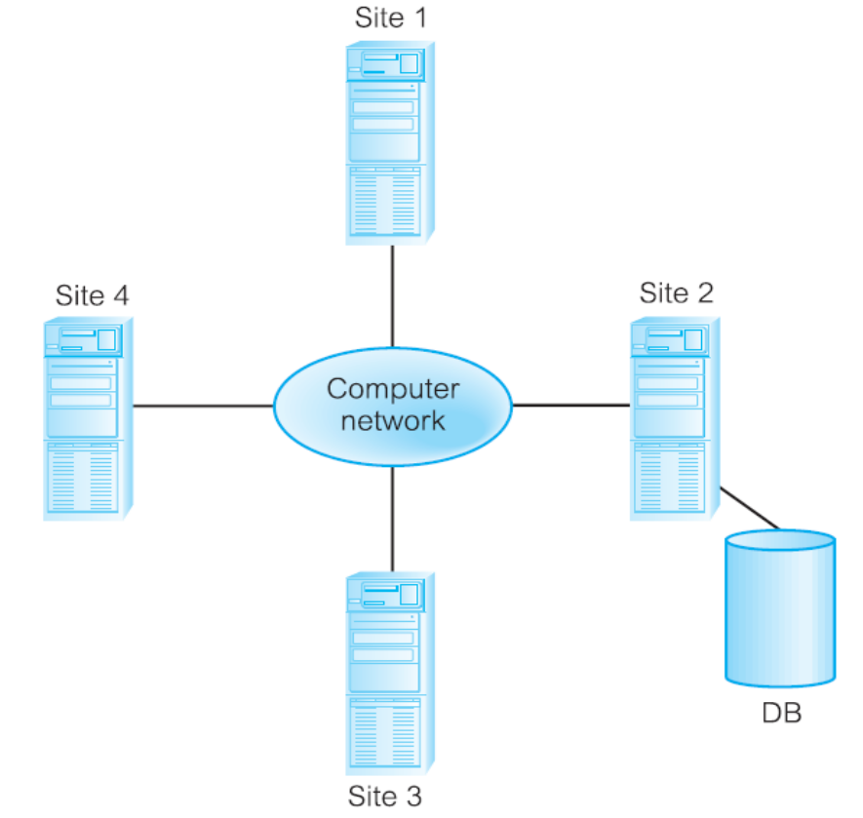
Distributed DBMS vs. Distributed Processing

Slide 6
Types of Distributed Database Systems
Distributed Database systems are classified on the basis of process distribution (single/multiple) and data distribution (single/multiple).
Accordingly, the following combinations are possible:
Single-Site Processing, Single-Site Data (SPSD)
Multiple-Site Processing, Single-Site Data (MPSD)
Multiple-Site Processing, Multiple-Site Data (MPMD)
  Homogenous DDBMS
  Heterogeneous DDBMS

Slide 7
Distributed Database Design
There are the following types of Distributed Databases on the basis of data distribution among the sites:
1. Data Fragmentation or Fragmentation
  a) Horizontal Fragmentation
  Round Robin Partitioning {R1,R2,…,R1000}
  Range partitioning based on a partition key (Location awareness)
  b) Vertical Fragmentation or Partitioning
  c) Mixed Fragmentation or Partitioning
2. Data Replication
The entire database or some of its fragments are replicated.
3. Hybrid
It makes use of the combinations of the above stated strategies according the significance and requirement of the data.

Slide 8
Distributed Database Design
1. Data Fragmentation or Partitioning
a) Horizontal Fragmentation
  It distributes the rows of a table into several separate tables and place them at the appropriate sites.
b) Vertical Partitioning
  It distributes the columns of a table into several separate tables place them at the appropriate sites.

Slide 9
Distributed Database Design
2. Data Replication:
Replicated data is subject to the mutual consistency rule, which requires that all copies of data fragments be identical.
Three replication scenarios
  Fully replicated All sites
  Partially replicated Subset
  Un-replicated Single Site

Slide 10
Distributed Database Design
2. Data Replication:
Synchronous distributed database technology (Push replication)
All data across the network are continuously kept up-to-date. After a data update, the originating DP node sends the changes to the replica nodes to ensure that data is immediately updated. Failing to make the changes at all the sites results in aborting the transaction.
Asynchronous distributed database technology (Pull replication)
One of the replicated copy is designated as a primary copy and the update operations are deemed to be completed as soon has the primary copy has been updated. Afterwards, the snapshot is sent to all the sites, where the fragment is replicated (such sites “subscribe” to the primary site). The replica nodes decide when to apply the updates to their local fragment.
Full refresh
Differential or Incremental refresh
Static vs. Dynamic ownership of data

Slide 11
Distributed Database Design
Criteria | Centralized | Replicated |  | Partitioned
 |  | Synchronized | Asynchronized
Locality of Reference | Lowest | Excellent | Excellent | High
Reliability | Lowest | Excellent | Good | High
Availability | Lowest |  | Highest | High
Storage Costs | Lowest | Highest | Highest | High
Load Distribution | Poor | Best | Best | Good
Communication Overhead | Highest | Low for retrieval | Low for retrieval | Low
Manageability | Good
Data Consistency | Excellent | Medium | Medium

Slide 12
Types of Distributed Databases
Criteria | Centralized | Replicated | Partitioned | Hybrid
Locality of Reference | Lowest | Highest | High | High
Reliability | Lowest | Highest | High | Average
Availability | Lowest | Highest | High | Average
Storage Costs | Lowest | Highest | High | Average
Load Distribution | Poor | Best | Good | Good
Communication Cost | Highest | Low for retrieval | Low | Low

Slide 13
Transparencies in DDBMS – Distribution Transparency
a) Fragmentation Transparency
This is the highest level of distribution transparency.
A user may treat a replicated data item as if it were a single item at a single site.
A DP captures all changes and pushes them to each remote replica. This introduces delays in the system and basically means that not all data changes are immediately seen by all replicas.
For near-real-time requirements, store and forward messages for each completed transaction can be broadcast across the network informing all nodes to update data as soon as possible, without forcing a confirmation to the originating node. One way to generate such messages is by using triggers.

Slide 14
Transparencies in DDBMS – Distribution Transparency
b) Location Transparency:
Location is the middle level of distribution transparency. With location transparency, the user must know how the data has been fragmented but still does not have to know the location of the data.
Since a transaction on Distributed DMS can be either a Local or Global transaction, therefore it should determine the location from which to retrieve data making the user feel as if all the data were located at a single node.
A user (or user program) using data need not know the location of the data.
If the DBMS does not directly support location transparency, a database administrator can accomplish virtual location transparency for users by creating views.
The distributed DBMS must have access to an accurate and current data dictionary/directory that indicates the location (or locations) of all data in the network. When the directories are distributed, they must be synchronized.

Slide 15
Distributed Database Design
Data Allocation
It describes the process of deciding where to locate data.
Centralized data allocation
Partitioned data allocation
Replicated data allocation

Slide 16
CAP Theorem
Dr. Eric Brewer states, “in any highly distributed data system there are three commonly desirable properties: Consistency, Availability, and Partition tolerance. However, it is impossible for a system to provide all three properties at the same time.”
Consistency. All nodes should see the same data at the same time, which means that the replicas should be immediately updated. However, this involves dealing with latency and network partitioning delays.
Availability. A request is always fulfilled by the system.
Partition tolerance. The system continues to operate even in the event of a node failure.

Slide 17
CAP Theorem
For example, imagine that you are using Amazon.com to buy tickets for a Manchester United–Barcelona soccer game in Washington, D.C. You may spend a few minutes browsing through the available tickets and checking the stadium website to see which seats have the best view. At the same time, other users from all over the world may be doing exactly the same thing. By the time you click the checkout button, the tickets you selected may already have been purchased by someone else! In this case, you will start again and select other tickets until you get the ones you want. The website is designed to work this way because Amazon prefers the small probability of having a few customers restart their transactions to having to lock the database to ensure consistency and leaving thousands of customers waiting for their webpages to refresh. If you have noticed the small countdown clock when using Ticketmaster to buy concert tickets, you have seen the same principle at work.

Slide 18
CAP Theorem
When dealing with highly distributed systems, some companies tend to forfeit the consistency and isolation components of the ACID properties to achieve higher availability.
This trade-off between consistency and availability has generated a new type of distributed data systems in which data is basically available, soft state, eventually consistent (BASE).
BASE refers to a data consistency model in which data changes are not immediate but propagate slowly through the system until all replicas are eventually consistent.

Slide 19
Distributed DBMS (DDBMS)
Architecture of DDBMS
Components of DDBMS
Functions & Objectives of DDBMS
Advantages of DDBMS
Disadvantages of DDBMS

Slide 20
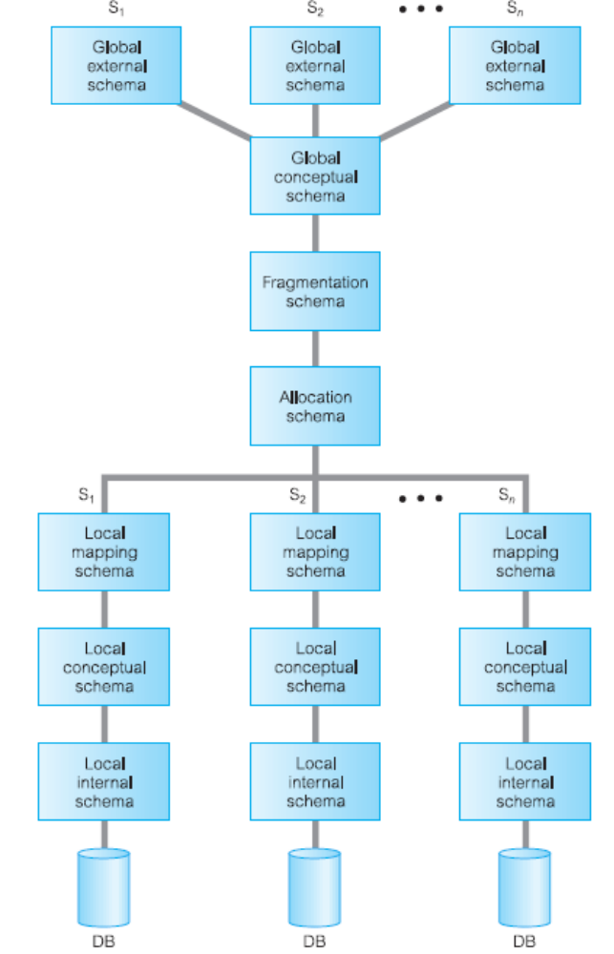
Architecture of DDBMS

Slide 21
Architecture of DDBMS
It consists of the following Schemas:
Fragmentation Schema: It describes how global relations are divided amongst the local sites.
Allocation Schema: It specifies at which site each fragment is stored.
Global Schema:
It is a logical description of the whole database, as if it were not distributed.
It is union of all the underlying local data fragments.

Slide 22
Components Distributed DBMS
Data Communication Component (DC).
Local DBMS.
Global or Distributed Data Dictionary (GD/D or DD/D).
Distributed DBMS (DDBMS).
( Fig. Next Slide)
Location of DD/D?

Slide 23
Components of Database Environment
Distributed
Repository
Distributed
Repository
DMBS
Application Programs
Local DBMS
DMBS
Application Programs
Local DBMS
Communication Controller
User Terminals
Database
Site 1
Database
Site n
User Terminals

Slide 24
Transparencies in DDBMS
A distributed DBMS should isolate users as much as possible from the complexities of distributed database management. Stated differently, the distributed DBMS should make transparent the location of data in the network as well as other features of a distributed database.
Distribution Transparency
  Fragmentation Transparency
  Location Transparency
  Replication Transparency
  Local mapping Transparency
Transaction Transparency
  Concurrency Transparency
  Failure Transparency
Performance Transparency
Full transparency is not a universally accepted objective!

Slide 25
Transparencies in DDBMS
Distribution Transparency
It allows a distributed database to be treated as a single Logical database.
Three levels of distribution transparency are:
Distribution transparency is supported by Distributed DD (DDD) or Distributed Data Catalog (DDC).
Name | Fragment Name | Location Name | Level
Fragmentation Transparency | No | No | High
Location Transparency | Yes | No | Medium
Local mapping Transparency | Yes | Yes | Low

Slide 26
Transparencies in DDBMS
Distribution Transparency
Distribution transparency is supported by Distributed DD (DDD) or Distributed Data Catalog (DDC).
The distributed DBMS must have access to an accurate and current data dictionary/directory that indicates the location (or locations) of all data in the network. When the directories are distributed, they must be synchronized.
If the DBMS does not directly support a certain type of distribution transparency, a DBA can accomplish it virtually for the users by creating views.

Slide 27
Transparencies in DDBMS – Distribution Transparency
a) Fragmentation Transparency
This is the highest level of distribution transparency.
The user does not need to know that the data is fragmented, so the user does not need to specify fragment names or data locations.

Slide 28
Transparencies in DDBMS – Distribution Transparency
b) Location Transparency:
Location is the middle level of distribution transparency. With location transparency, the user must know how the data has been fragmented but still does not have to know the location of the data.
c) Replication transparency
Closely related to location transparency is replication transparency, which means that the user is unaware of the replication of fragments.
d) Local mapping transparency
This is the lowest level of distribution transparency. With local mapping transparency, the user needs to specify both fragment names and the location of data items,

Slide 29
Transparencies in DDBMS – Distribution Transparency
Example
Consider a database table EMP divided into three fragments E1, E2, and E3 deployed at three locations New York, Atlanta and Miami respectively. is the middle level of distribution transparency. With location transparency, the user must know how the data has been fragmented but still does not have to know the location of the data.
Query with Fragmentation transparency
SELECT *
FROM EMPLOYEE
WHERE EMP_DOB < '01-JAN-1979';

Slide 30
Transparencies in DDBMS – Distribution Transparency
Query with Location transparency
SELECT * FROM E1
WHERE EMP_DOB < '01-JAN-1979'
UNION
SELECT * FROM E2
WHERE EMP_DOB < '01-JAN-1979'
UNION
SELECT * FROM E3
WHERE EMP_DOB < '01-JAN-1979'

Slide 31
Transparencies in DDBMS – Distribution Transparency
Query with Local Mapping transparency
SELECT * FROM E1 NODE NY
WHERE EMP_DOB < '01-JAN-1979'
UNION
SELECT * FROM E2 NODE ATL
WHERE EMP_DOB < '01-JAN-1979'
UNION
SELECT * FROM E3 NODE MIA
WHERE EMP_DOB < '01-JAN-1979'

Slide 32
Transparencies in DDBMS
2. Transaction Transparency
Transaction transparency ensures that the transaction will be completed only when all database sites involved in the transaction complete their part of the transaction.
A remote transaction accesses data at a single remote site, whereas, a distributed transaction can reference several different local or remote DP sites.
A distributed transaction has many subtransactions involving multiple sites. Along with the atomicity of the transaction, DDBMS must also ensure the atomicity of each subtransactions.
Transaction transparency in a distributed DBMS is complicated by the fragmentation, allocation, and replication schemas.

Slide 33
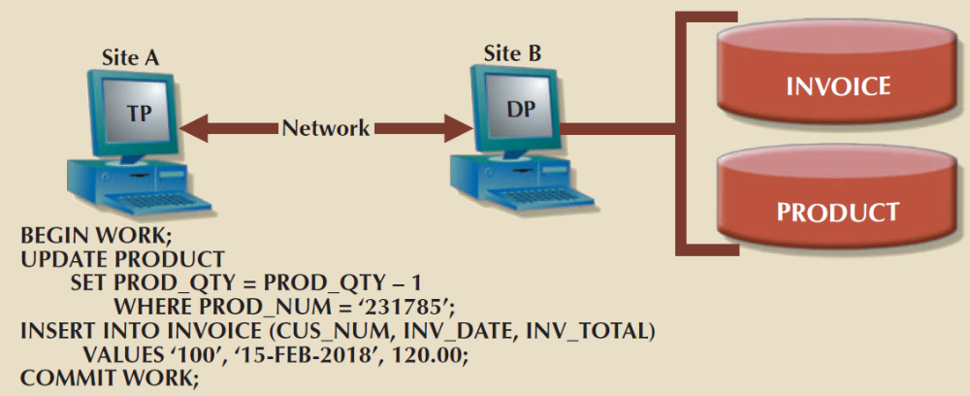
Transparencies in DDBMS
2. Transaction Transparency
Remote Transaction

Slide 34
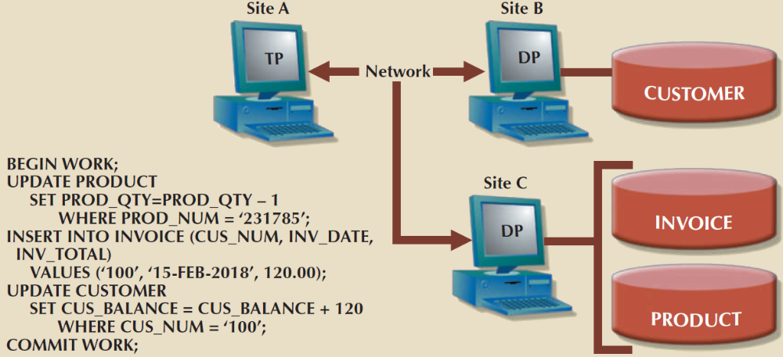
Transparencies in DDBMS
2. Transaction Transparency
Distribution Transaction

Slide 35
Transparencies in DDBMS –
Transaction Transparency
a) Concurrency Transparency
Concurrency control becomes especially important in distributed databases because multisite, multiple-process operations are more likely to create data inconsistencies and deadlocked transactions than single-site systems.
Suppose that a transaction updates data at three DP sites. The first two DP sites complete the transaction and commit the data at each local DP; however, the third DP site cannot commit the transaction. Such a scenario would yield an inconsistent database.
The solution to this problem is a two-phase commit protocol.
The two-phase commit protocol (2PC) guarantees that if a portion of a transaction operation cannot be committed, all changes made at the other sites participating in the transaction will be undone to maintain a consistent database state.

Slide 36
Transparencies in DDBMS
a) Concurrency Transparency
The two-phase commit protocol defines the operations between two types of nodes: the coordinator and one or more subordinates. Generally, the coordinator role is assigned to the node that initiates the transaction.
Phase 1: Preparation - The coordinator sends a PREPARE TO COMMIT message to all subordinates.
Phase 2: The Final COMMIT - The coordinator broadcasts a COMMIT message to all subordinates and waits for the replies. If one or more subordinates do not commit, the coordinator sends an ABORT message, thereby forcing them to UNDO all changes.

Slide 37
Transparencies in DDBMS –
Transaction Transparency
b) Failure Transparency
It ensures that the system will continue to operate in the case of a node or network failure.
In addition to the recovery features of DBMS, DDBMS must also cater for failure of communication link, the loss of message, the failure of a site etc.
With failure transparency, either all the actions of a transaction are committed or none of them is committed. Once a transaction occurs, its effects survive hardware and software failures.

Slide 38
Transparencies in DDBMS
4. Performance Transparency
It is the process of minimizing the response time of a query involving multiple sites.
In a distributed environment, the system should not suffer any performance degradation due to the distributed architecture,
A Distributed Query Processor (DQP) considers the cardinalities of the involved relations and then make the optimal data movement among the sites. DQP decides
  which fragment to access;
  which copy of a fragment to use, if the fragment is replicated;
  which location to use.

Slide 39
Transparencies in DDBMS
4. Performance Transparency
Suppose we want to process a query involving all the relations given above.
Relation | Cardinality | Location
SUPPLIER (Supplier#,…., City) | 10,000 Records | Sialkot
PART (Part#, ……) | 100,000 Records | Lahore
SHIPMENT (Supplier#, Part#,….) | 1,000,000 Records | Sialkot

Slide 40
Functions & Objectives of DDBMS
4. Performance Transparency (DQP)
SELECT S.Supplier# FROM SUPPLIER S, SHIPMENT T, PART P
WHERE S.city = ‘Gujranwala’
AND S.Supplier# = T.Supplier#
AND T.part# = P.part#
AND P.color = ‘Red’;

Slide 41
Transparencies in DDBMS
4. Performance Transparency
Method | Time
Move PART relation to Sialkot, and process the whole query at Sialkot | 18.7 Mins.
Move SUPPIER and SHIPMENT relation to Lahore, and process the whole query at Lahore | 28 Hours
Select just Red PARTs at Lahore computer, and move the result to Sialkot for matching with Gujranwala Suppliers. | 1 Second
Join SUPPLIER and SHIPMENT at the Sialkot computer, PROJECT these down to only tuples for Gujranwala suppliers, and then for each of these check at the Lahore computer to determine if the associated PART is red. | ???

Slide 42
Advantages of Distributed Databases
Increased Reliability & Availability: A Distributed System will continue to function at some reduced level even when some sites are not functioning.
Local Control or Autonomy: Distributing the data increases local control, which promotes improved data integrity and administration.
Modular Growth (Scalability)
Lower Communication Costs
Faster Response

Slide 43
Disadvantages of Distributed Databases
Software Cost and Complexity
Processing Overhead: The various sites must exchange messages to ensure proper coordination among the sites.
Data integrity.
Slow Response in some cases.

Slide 44
Thank you for your attention.
Asif Sohail
Assistant Professor
University of the Punjab
Punjab University College of Information Technology (PUCIT)
Allama Iqbal (Old) Campus, Anarkali
Lahore, Pakistan
Tel: +92-(0)42-111-923-923 Ext. 154
E-mail: asif@pucit.edu.pk

